Slide 1

Final Project BDAT 1001: ASP .NET Core Web App & Data Security
Presented By:
Rebecca Ashade-Alabi - 200556747
Eniayo Ibirogba - 200562076
Ememobong Ubia - 200559326
April 10, 2023

Slide 2
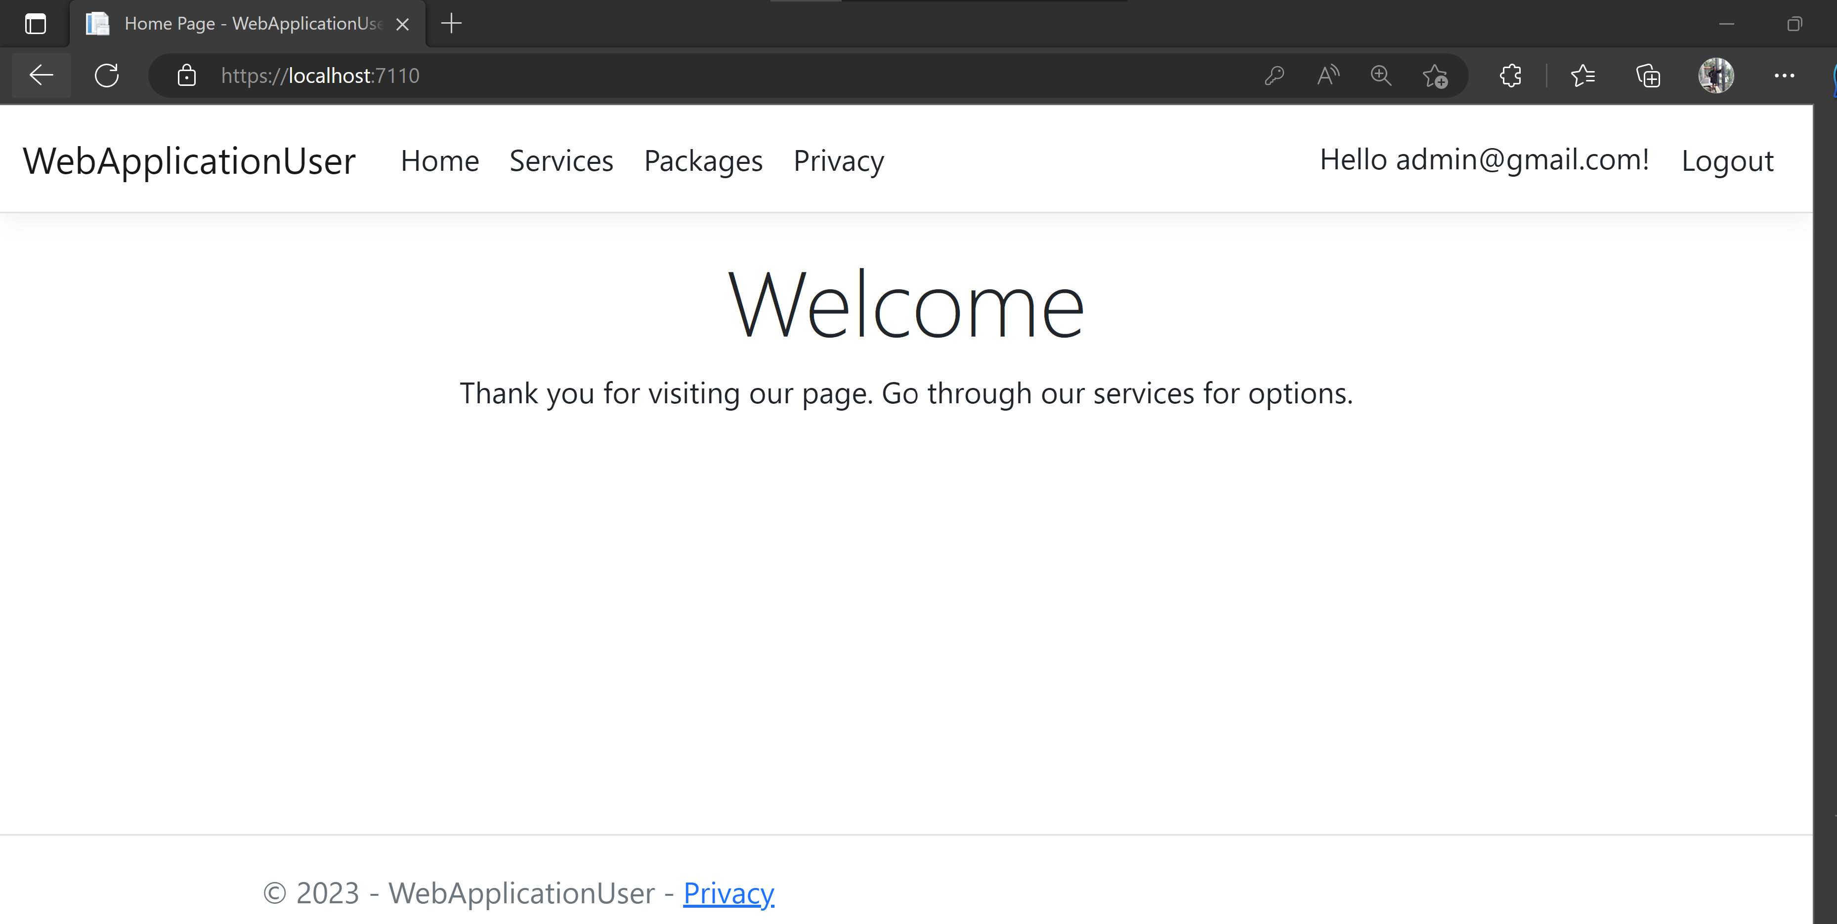
WebAppUser App: Service provider with options and packages. Registered Users option & update Admin login with private access to packages.

Slide 3
How can we transfer personal data securely within their network?
Email Encryption: web-based that uses secure link accessed through secure email server. Recipients and sender alike that view messages and attachments securely.
Website Encryption: uses Secure Sockets Layer (SSL) for encryption and allows transfer of data over the website. It is not sophisticated but reduces data breach on website usage (Penta Security, 2020).
Off the Record Messaging (OTR): used for messaging platforms offering encryption of messages before their transmission.
File Transfer Protocol (FTP) & SFTP: One of the safest and requires authentication by use of username and password with access to a server that enables download and upload. Connection is encrypted and authentication protects files.
Secure HyperText Transfer Protocol: use Transport Layer Security (TLS) and used for hypertext transfer between a server and browser. Encryption needs to be added to the HTTP/HTTPS for user validation.
Notes:
McHugh, B. (2022, June 24). Secure File Transfers: Best Practices, Protocols And Tools. Retrieved from ActiveBatch: https://www.advsyscon.com/blog/secure-file-transfers/#:~:text=Top%20Protocols%20For%20Secure%20File%20Transfer%201%20SSH,%28OFTP2%29%20...%205%20User%20Datagram%20Protocol%20%28UDP%29%20

Slide 4
What security protocol is best for transferring personal files?
The idea of best protocol is hinged the needs of the individual or company using it, and the budget available. Some of the best protocols are SFTP built on secure shell cryptography, File Transfer Protocol Over SSL (FTPS), Applicability Statement 2 (AS2) used by trading partners in retail and automotive and enables digital signatures, among others (McHugh, 2022). The evolving best practices and demands due to regulation requirements involve;
Centralization file management and transfer systems that ensures single point of control with IT teams.
Cloud storage and management
Workflow automation and complexity reduction is a good practice.
Security protocol layering for increased protection and security.
Notes:
Penta Security. (2020, 10 23). What Are The Top Secure Data Transmission Methods? Retrieved from Penta Security: https://www.pentasecurity.com/blog/top-secure-data-transmission-methods/#:~:text=What%20Are%20The%20Top%20Secure%20Data%20Transmission%20Methods%3F,...%208%20Near%20Field%20Communication%20...%20More%20items

Slide 5
Can you encode and decode Images?
Images can be encoded and encrypted using cryptographic algorithms to protect their confidentiality and integrity during transmission or storage.
This involves scrambling the image data with the help of techniques such as symmetric key encryption, public key encryption, or watermarking. Image encoding is simply converting the image from one format to another.
Notes:
Shiva, S. G. (2014). Image encryption using symmetric key cryptography with hash function. International Journal of Advanced Research in Computer and Communication Engineering, 3(7), 6729-6735. http://ijarcce.com/wp-content/uploads/2014/07/IJARCCE8D1_61.pdf

Slide 6
Can you explain the architecture of a secure API?
To build a secure API, you should consider using a combination of security mechanisms such as authentication, authorization, and encryption. The architecture of a secure API involves implementing these mechanisms in a layered approach, starting from the transport layer, through the application layer, and down to the data layer.
At the application layer, you should use secure authentication and authorization mechanisms to ensure that only authorized users can access the API.
At the data layer, you should use encryption and access controls to protect sensitive data stored in the database.
Notes:
Raza, S., & Rajput, M. A. (2019). A survey on security challenges in API development. Journal of Cybersecurity, 5(1), tyz008. https://doi.org/10.1093/cybsec/tyz008

Slide 7
Can you recommend a secure framework for coding an API?
There are several secure frameworks for coding an API, each with its own strengths and weaknesses. Some popular options include:
Spring Security: a Java-based framework that provides comprehensive security features for web applications, including APIs. It includes features such as authentication, authorization, and session management, and is highly configurable.
Laravel: a PHP-based framework that provides a simple and elegant API development experience. It includes features such as authentication, rate limiting, and API versioning.
Django: a Python-based framework that provides a robust and scalable platform for building APIs. It includes features such as authentication, authorization, and serialization, and is well-suited for building complex APIs.
Ultimately, the choice of framework will depend on the specific requirements of your project, such as the programming language, scalability, and security features needed.
Notes:
Lau, G. (2022, October 5). The Whats and Hows of APIs: A New Developer’s Guide. DevOps.com. https://devops.com/the-whats-and-hows-of-apis-a-new-developers-guide/

Slide 8
What data interchange format should we use while transferring data between locations?
The choice of data interchange format will depend on the specific requirements of your project, as well as the types of data being transferred. Some popular options include:
JSON (JavaScript Object Notation): a lightweight and easy-to-parse format that is widely used for web APIs. It is simple and flexible, making it a good choice for transferring data between different platforms and languages.
XML (Extensible Markup Language): a verbose but flexible format that is commonly used for data exchange in enterprise systems. It provides a standard way of defining data structures and is well-suited for transferring large and complex data sets.
Protocol Buffers: a binary format developed by Google that is designed for high-performance data exchange. It is highly efficient and can be used with a wide range of programming languages.
Overall, the choice of data interchange format should be based on the specific requirements of your project, including the size and complexity of the data being transferred, as well as the platforms and languages involved.
Notes:
Fielding, R. T., & Taylor, R. N. (2002). Principled design of the modern Web architecture. ACM Transactions on Internet Technology (TOIT), 2(2), 115-150.

Slide 9
Recommended Secure Data Storage Best Practices?
Classify Your Data and Determine Storage Requirements - Identify and classify data based on its sensitivity and importance. The next move is to decide on the type of storage media based on the size of the data and the level of access required (Coggins, 2021).
Use Encryption - Encrypt data at rest and in transit to prevent unauthorized access, using algorithms like AES or RSA
Implement Access Controls - Use access controls to restrict access to data based on user permissions. Firewalls, ACLs RBACs are some of the recommended technologies for access control.
Use Data Backups - Use backup and recovery software to make copies of data and store them in a physically secure location.
Ensure continuous security and data integrity - Ensure regular software and firmware updates, implement multifactor authentication for access, systems logs monitoring for suspicious activity and audits to identify vulnerabilities for immediate fixes.
Secure data storage is critical to protect sensitive data from unauthorized access, theft, and loss. By following these best practices, organizations can ensure data availability and integrity, comply with data protection regulations, and reduce the risk of data breaches. Using cost-effective solutions like cloud storage providers or open-source backup and recovery software can help organizations achieve secure data storage without breaking the bank (Terry Lanfear).
Notes:
Coggins, J. (2021, January 28). What is data classification and how to do it effectively. Lepide Blog: A Guide to IT Security, Compliance and IT Operations. Retrieved April 9, 2023, from https://www.lepide.com/blog/what-is-data-classification-and-how-to-do-it/

Slide 10
Ethical concerns related to the transmission of personal data.
Ethical concerns is concerned with ensuring the protection of personal privacy, maintaining data confidentiality, and complying with data protection regulations such as GDPR, HIPAA, or CCPA ( Fabiano, 2019). It mostly relates to:
Privacy: Personal data is sensitive and private information should be protected from unauthorized access, theft, or misuse. Organizations have an ethical responsibility to ensure that personal data is collected, stored, and transmitted securely (Whitney et al., 2022).
Confidentiality: Personal data should only be accessed by individuals who have a legitimate reason to do so. Organizations have an ethical responsibility to protect personal data from unauthorized access, sharing, or disclosure.
Notes:
Fabiano, N. (2019, July). (PDF) ethics and the protection of personal data - researchgate. Research Gate. Retrieved April 9, 2023, from https://www.researchgate.net/publication/334374184_Ethics_and_the_protection_of_personal_data
Whitney, L., Staff, T. R., Azhar, A., Branscombe, M., Hughes, O., Partida, D., & Greenberg, K. (2022, November 3). Data privacy is a growing concern for more consumers. TechRepublic. Retrieved April 9, 2023, from https://www.techrepublic.com/article/data-privacy-is-a-growing-concern-for-more-consumers/
What is the importance of confidentiality? (with examples). (n.d.). Retrieved April 9, 2023, from https://uk.indeed.com/career-advice/career-development/importance-of-confidentiality

Slide 11
Ethical concerns related to the transmission of personal data Cont’D.
Consent: Individuals have the right to know how their personal data is being used and to give their informed consent for its use. Organizations have an ethical responsibility to obtain explicit consent from individuals before collecting, processing, or transmitting their personal data.
Data protection regulations: Compliance with data protection regulations such as GDPR, HIPAA, or CCPA is an ethical responsibility for organizations that collect, store, or transmit personal data. These regulations are designed to protect individuals' privacy and ensure that personal data is handled in a secure and ethical manner.
Cybersecurity: Organizations have an ethical responsibility to protect personal data from cyber threats such as hacking, malware, or phishing attacks. A breach of personal data not only puts individuals at risk of identity theft, but it can also damage an organization's reputation and trust with its customers.

Slide 12


Thank you

